Slide 1

Intermission 2

Slide 2
Agenda
Bigger Picture: A personal perspective not found in textbooks
Corpora
Lexical Semantics
Word Associations
Information Theory
PMI → Word2Vec → Bots

Slide 3
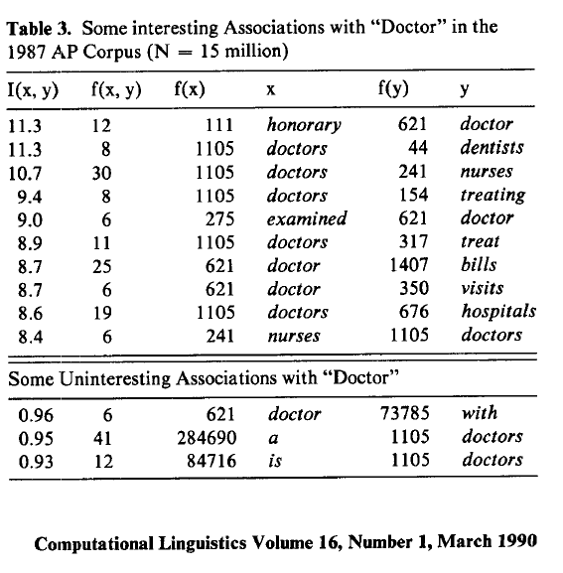
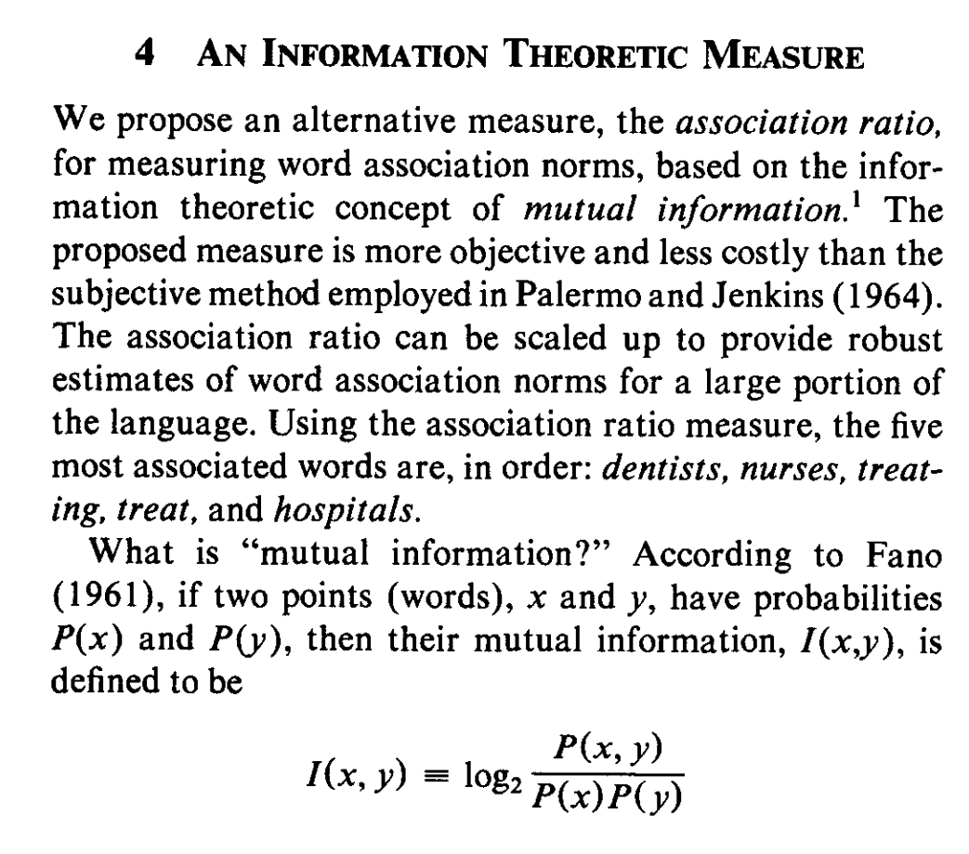
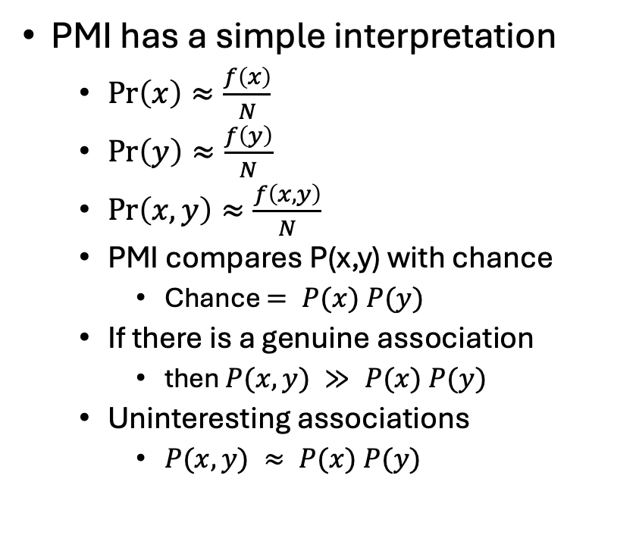
Pointwise Mutual Information (PMI)
PMI has a simple interpretation
$\operatorname{Pr}\left(x\right)≈\frac{f\left(x\right)}{N}$
$\operatorname{Pr}\left(y\right)≈\frac{f\left(y\right)}{N}$
$\operatorname{Pr}\left(x,y\right)≈\frac{f\left(x,y\right)}{N}$
PMI compares P(x,y) with chance
Chance $= P(x) P(y)$
If there is a genuine association
then $P(x,y) ≫ P(x) P(y)$
Uninteresting associations
$P(x,y) ≈ P(x) P(y)$

Slide 4
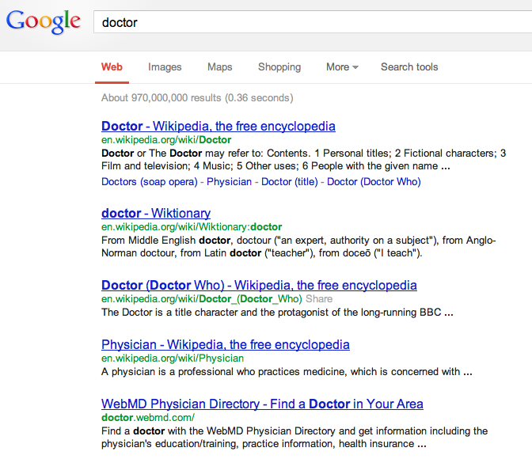
There is no data like more data
Counts are growing 1000x per decade
(same as disks)
Counts are growing 1000x per decade
(same as disks)
Rising Tide of Data Lifts All Boats

Slide 5
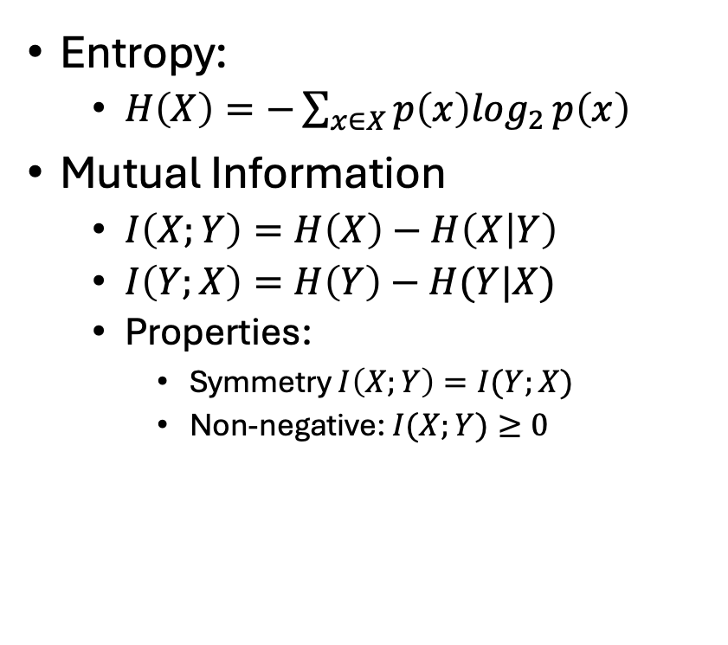
Pointwise Mutual Information (PMI)
Entropy:
$H\left(X\right)=−\sum_{x∈X}{p\left(x\right)\log_{2}}p\left(x\right)$
Mutual Information
$I\left(X;Y\right)=H\left(X\right)−H\left(X | Y\right)$
$I\left(Y;X\right)=H\left(Y\right)−H(Y|X)$
Properties:
Symmetry $I\left(X;Y\right)=I(Y;X)$
Non-negative: $I(X;Y)≥0$
Pointwise

Slide 6
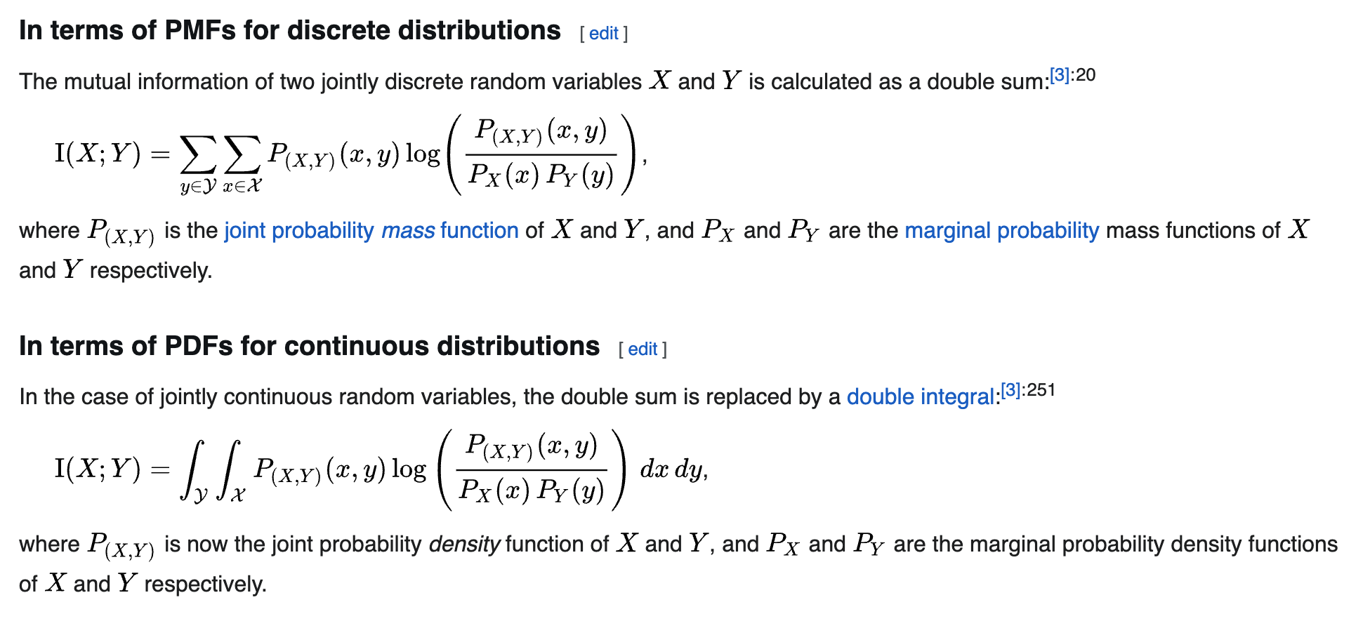
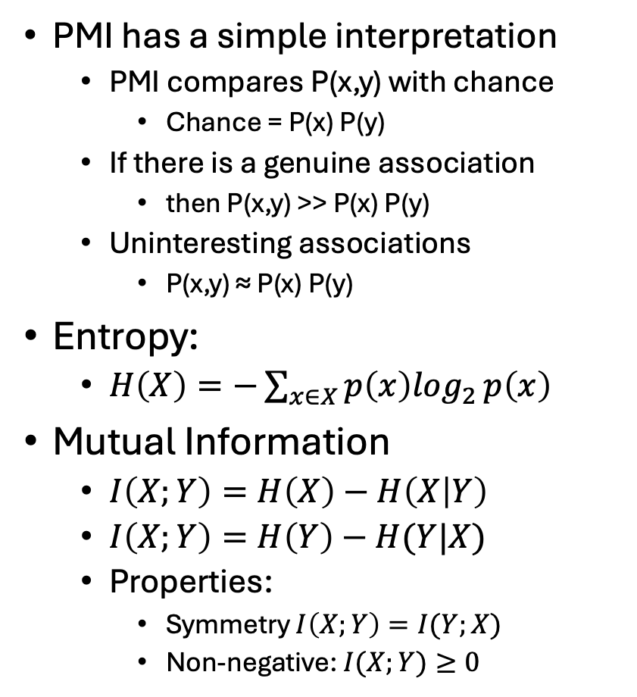
Pointwise Mutual Information (PMI)
PMI has a simple interpretation
PMI compares P(x,y) with chance
Chance = P(x) P(y)
If there is a genuine association
then P(x,y) >> P(x) P(y)
Uninteresting associations
P(x,y) ≈ P(x) P(y)
Entropy:
$H\left(X\right)=−\sum_{x∈X}{p\left(x\right)\log_{2}}p\left(x\right)$
Mutual Information
$I\left(X;Y\right)=H\left(X\right)−H\left(X | Y\right)$
$I\left(X;Y\right)=H\left(Y\right)−H(Y|X)$
Properties:
Symmetry $I\left(X;Y\right)=I(Y;X)$
Non-negative: $I(X;Y)≥0$
Pointwise

Slide 7
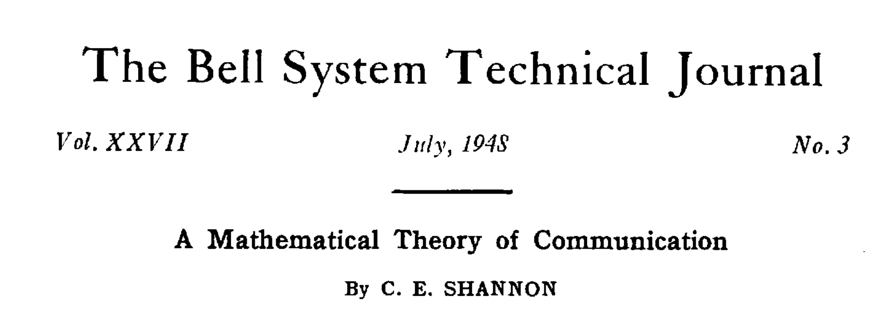
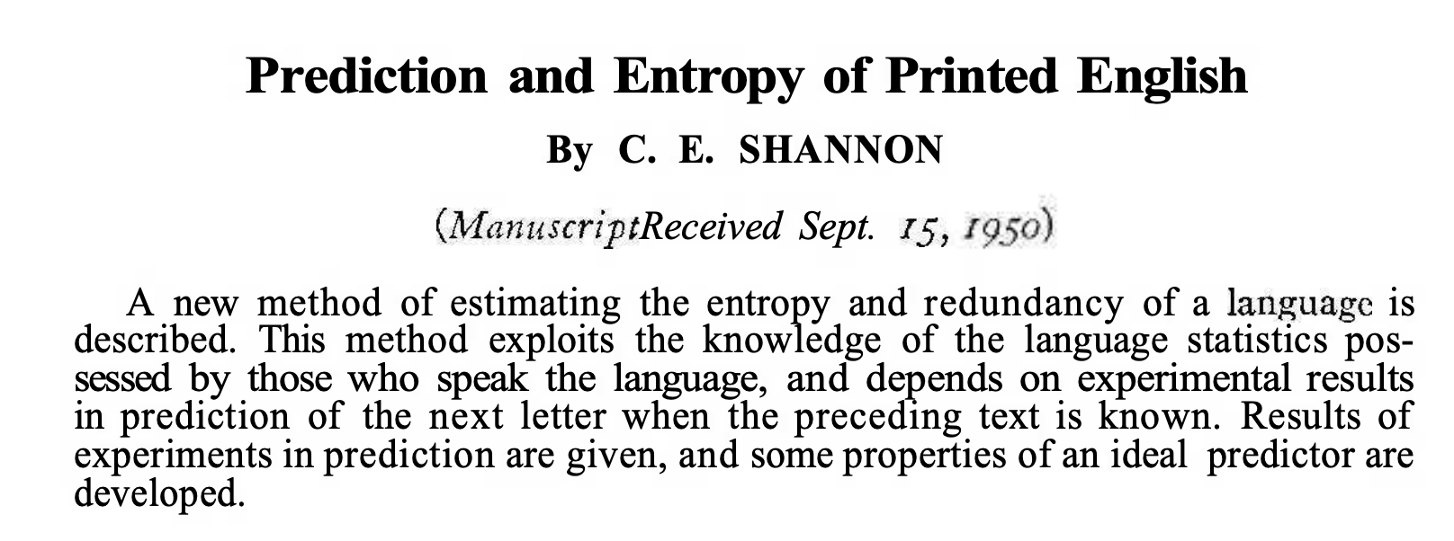

Slide 8
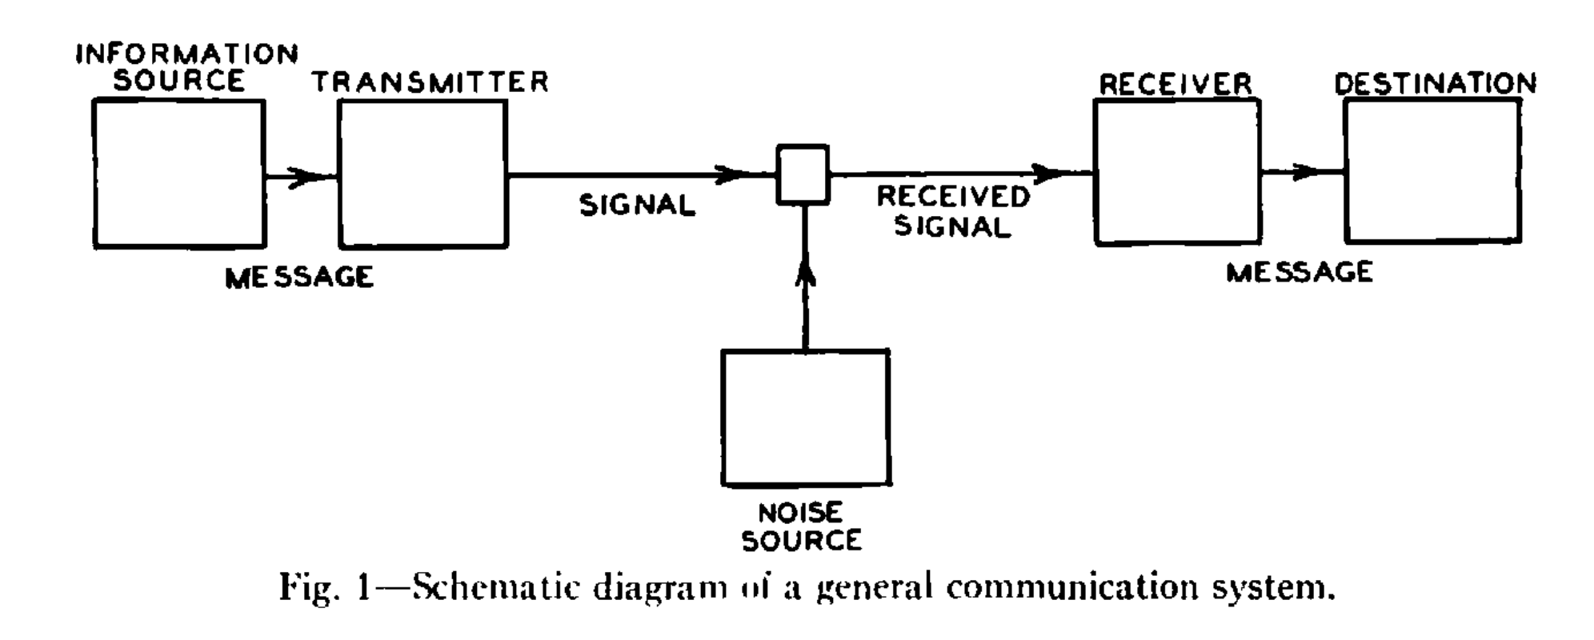


Telephone
$$X$$
$$Y$$

Slide 9
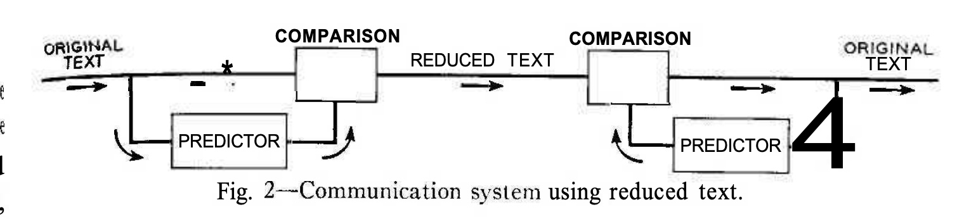
Telephone
Gzip
Encoder
Decoder

Slide 10
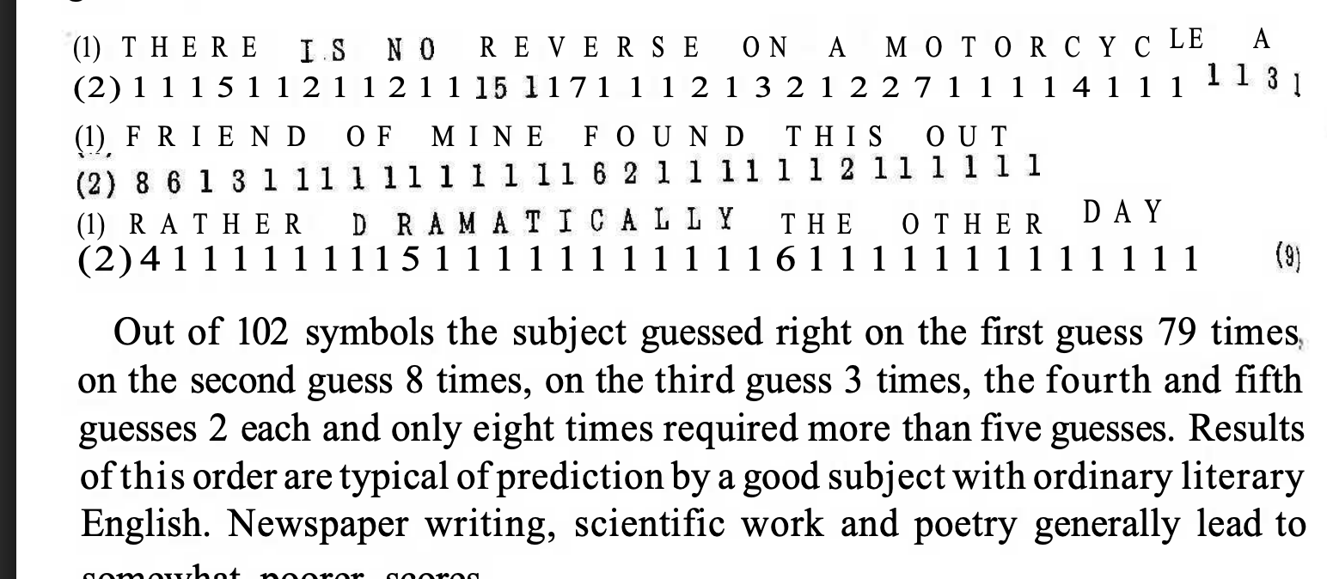

Slide 11
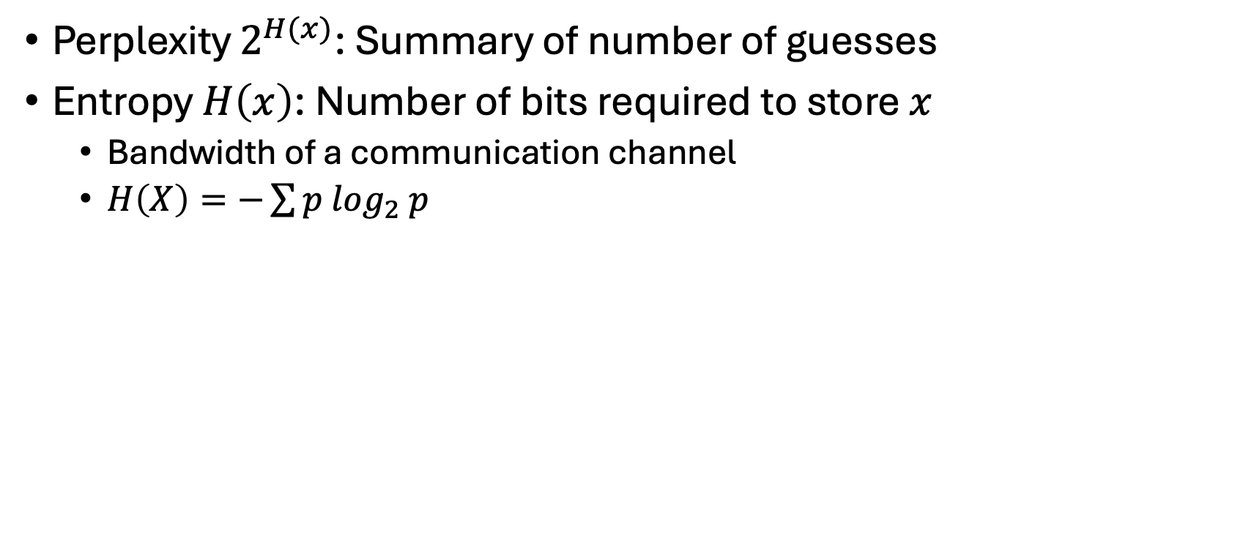
Perplexity & Entropy
Lexical Retrieval
Perplexity $2^{H(x)}$: Summary of number of guesses
Entropy $H\left(x\right)$: Number of bits required to store $x$
Bandwidth of a communication channel
$H\left(X\right)=−\sum{p\log_{2} p}$
Gzip

Slide 12
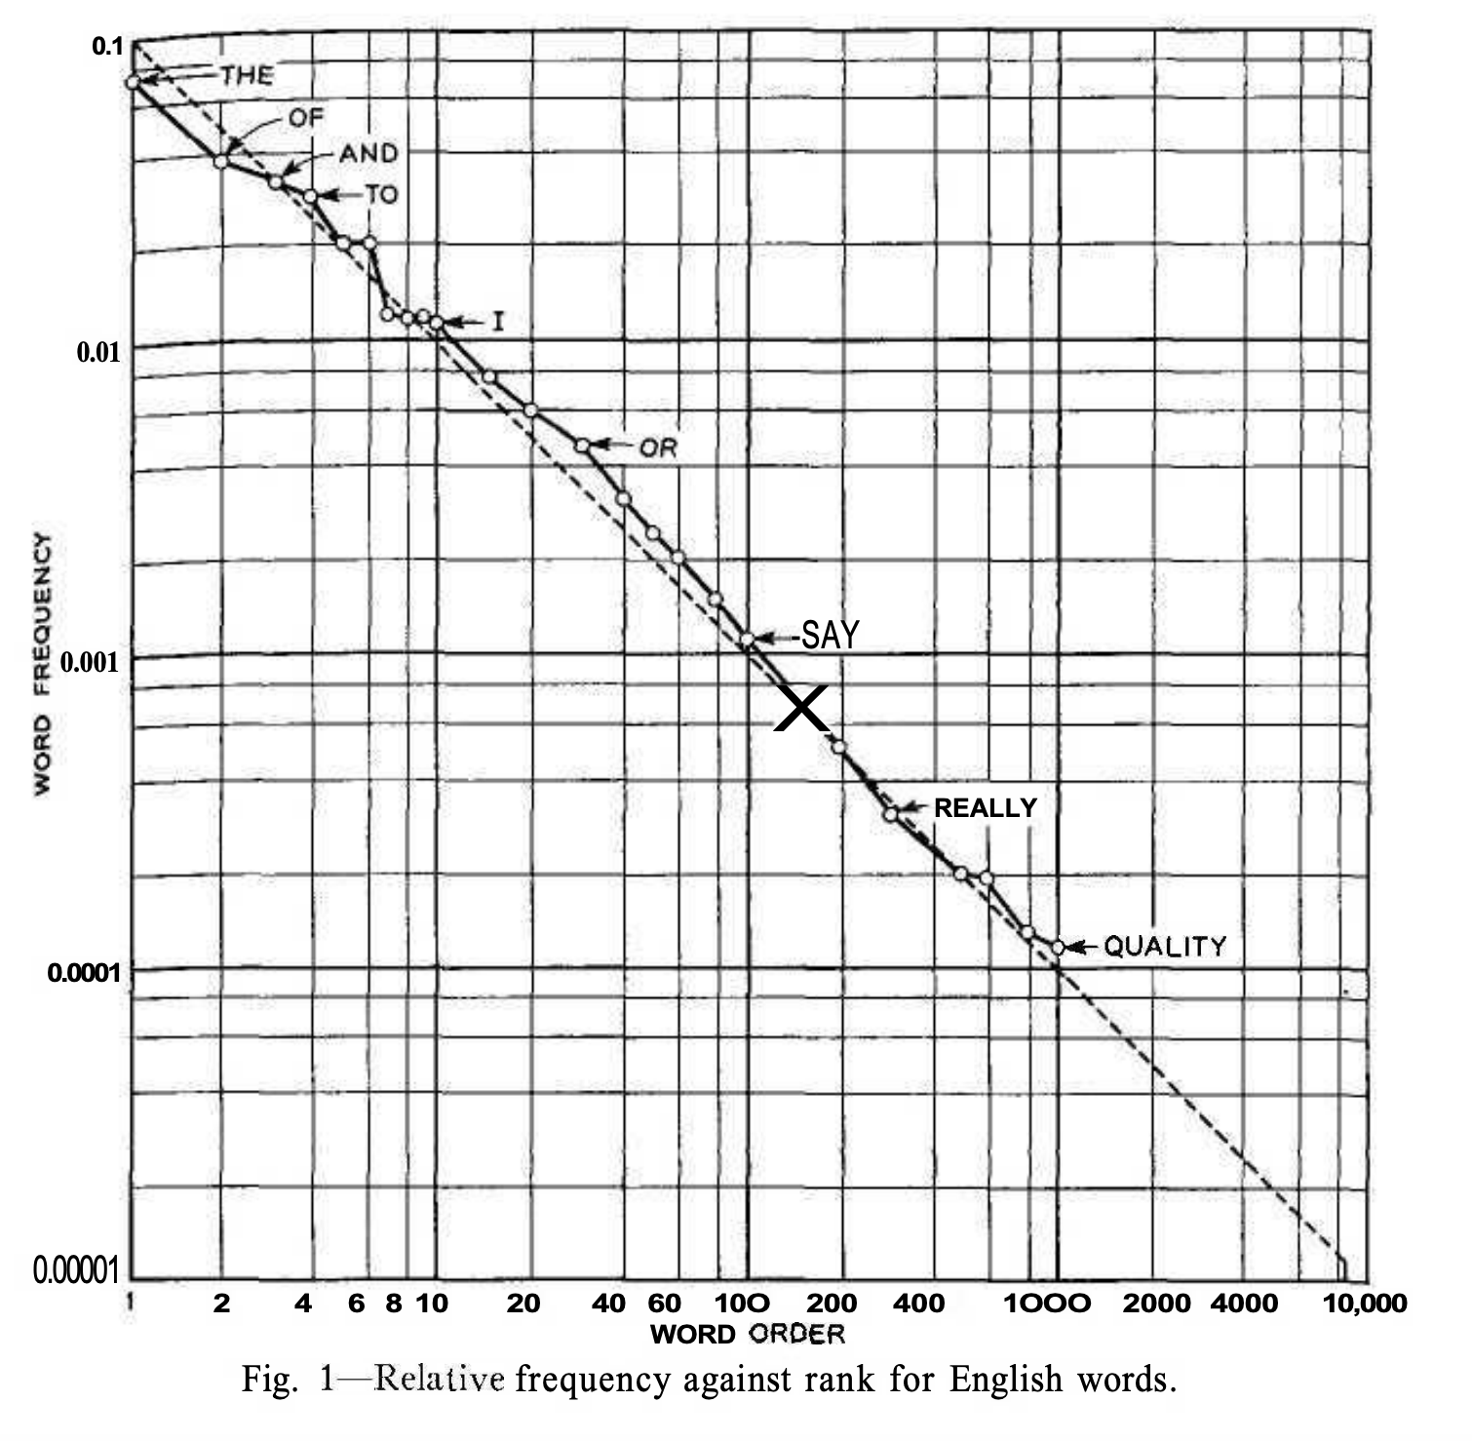
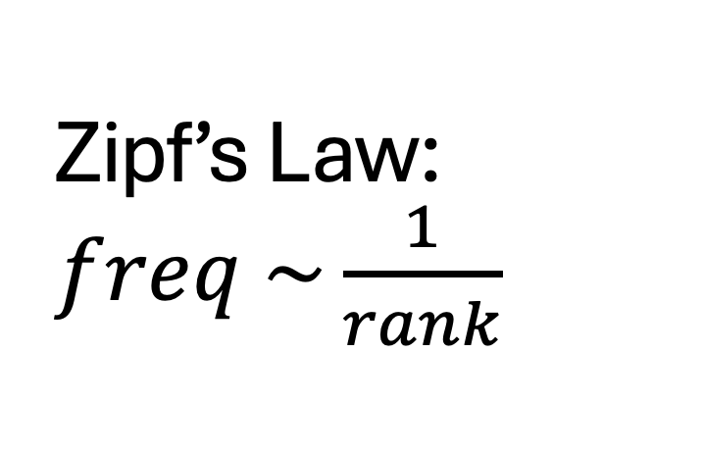
Zipf’s Law: $freq \sim \frac{1}{rank}$
Function Words
Non-uniform probabilities → Opportunities for compression
Content Words

Slide 13
Agenda
Bigger Picture: A personal perspective not found in textbooks
Corpora
Lexical Semantics
Word Associations
Information Theory
PMI → Word2Vec → Bots

Slide 14
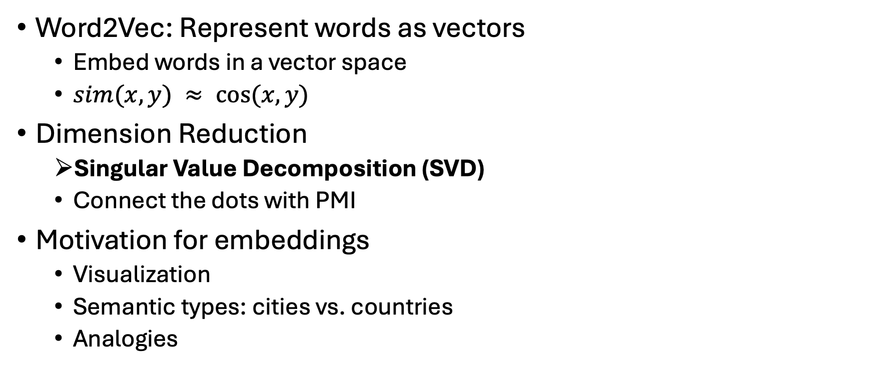
PMI → Word2Vec
Word2Vec: Represent words as vectors
Embed words in a vector space
$sim(x,y) ≈ cos⁡(x,y)$
Dimension Reduction
Singular Value Decomposition (SVD)
Connect the dots with PMI
Motivation for embeddings
Visualization
Semantic types: cities vs. countries
Analogies

Slide 15
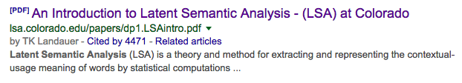
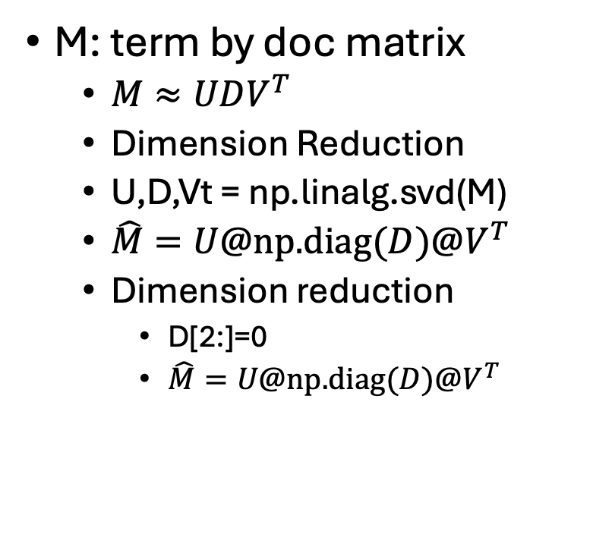
SVD: Singular Value Decomposition
 | c1 | c2 | c3 | c4 | c5 | m1 | m2 | m3 | m4
human | 1 | 0 | 0 | 1 | 0 | 0 | 0 | 0 | 0
interface | 1 | 0 | 1 | 0 | 0 | 0 | 0 | 0 | 0
computer | 1 | 1 | 0 | 0 | 0 | 0 | 0 | 0 | 0
user | 0 | 1 | 1 | 0 | 1 | 0 | 0 | 0 | 0
system | 0 | 1 | 1 | 2 | 0 | 0 | 0 | 0 | 0
response | 0 | 1 | 0 | 0 | 1 | 0 | 0 | 0 | 0
time | 0 | 1 | 0 | 0 | 1 | 0 | 0 | 0 | 0
EPS | 0 | 0 | 1 | 1 | 0 | 0 | 0 | 0 | 0
survey | 0 | 1 | 0 | 0 | 0 | 0 | 0 | 0 | 1
trees | 0 | 0 | 0 | 0 | 0 | 1 | 1 | 1 | 0
graph | 0 | 0 | 0 | 0 | 0 | 0 | 1 | 1 | 1
minors | 0 | 0 | 0 | 0 | 0 | 0 | 0 | 1 | 1
M: term by doc matrix
$M≈UDV^{T}$
Dimension Reduction
U,D,Vt = np.linalg.svd(M)
$\hat{M}=U@\text{np}\text{.}\text{diag}(D)@V^{T}$
Dimension reduction
D[2:]=0
$\hat{M}=U@\text{np}\text{.}\text{diag}(D)@V^{T}$

Slide 16
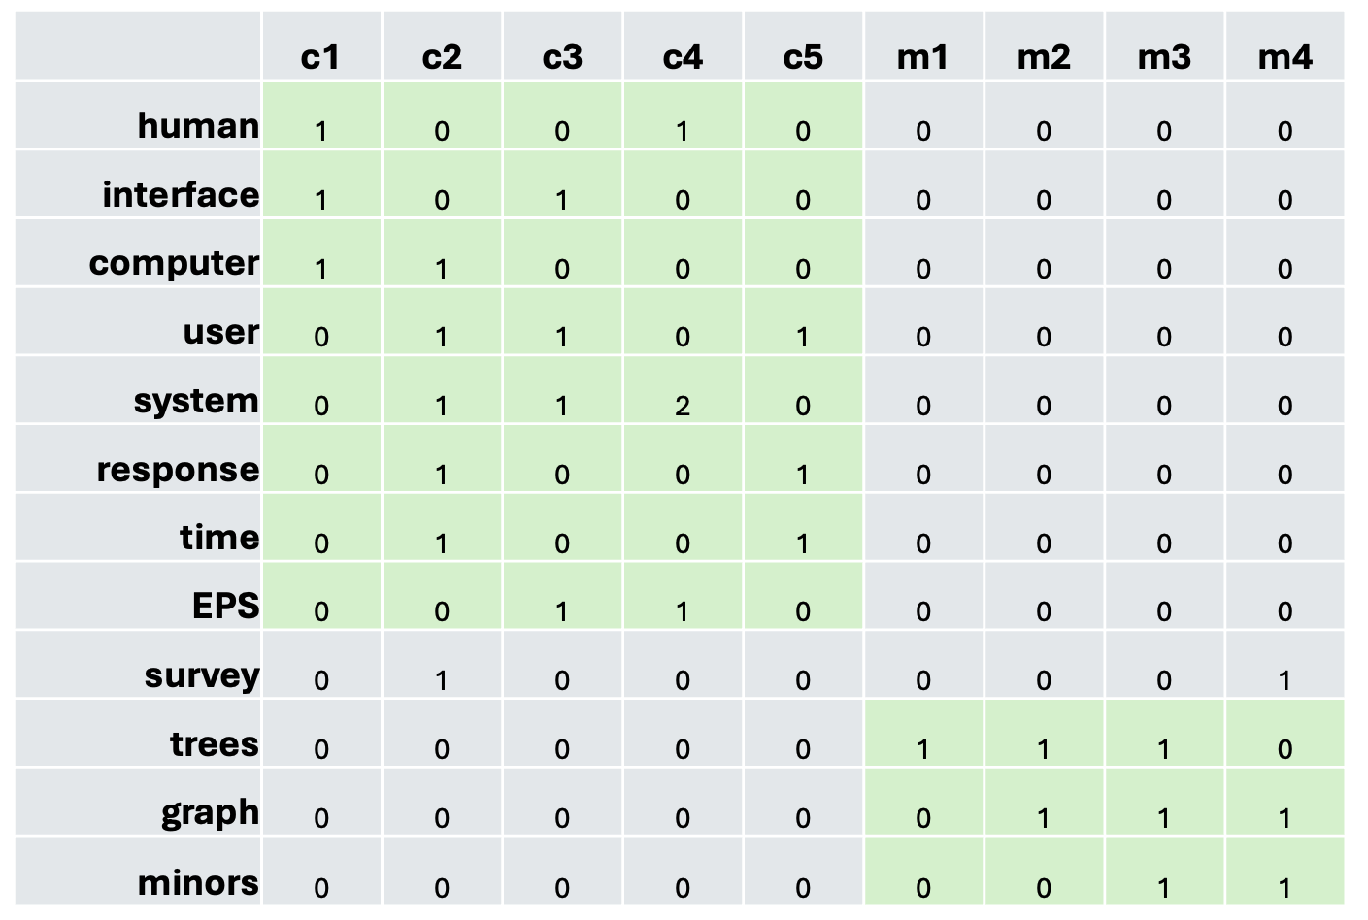
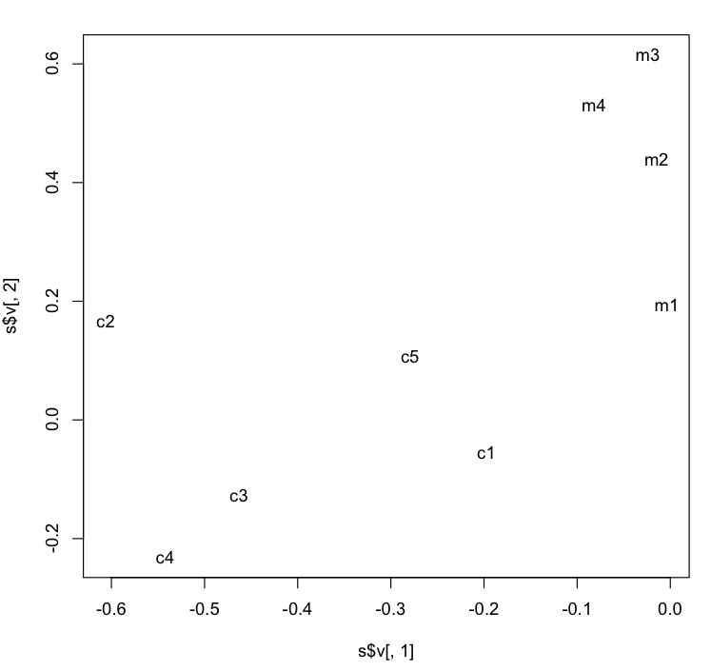
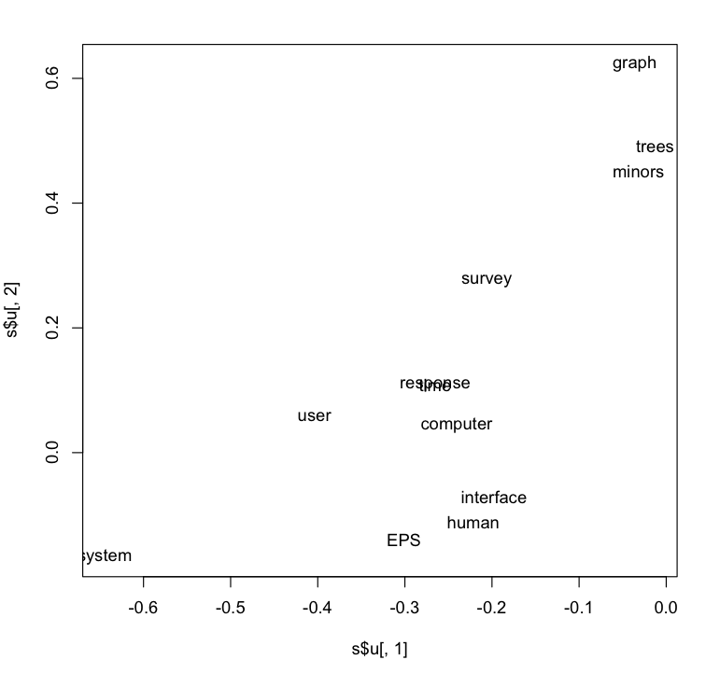
Dimension Reduction → Visualization

Slide 17
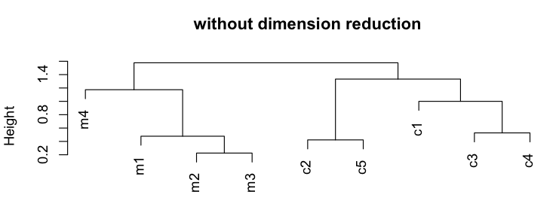
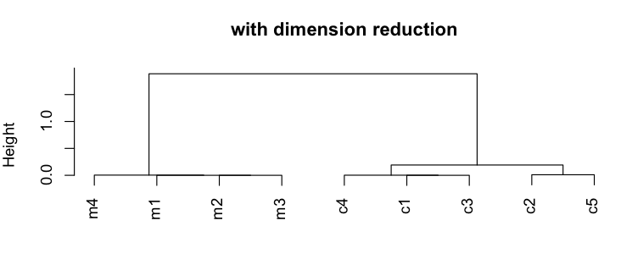
plot(hclust(as.dist(1-cor(m)))
 | c1 | c2 | c3 | c4 | c5 | m1 | m2 | m3 | m4
human | 1 | 0 | 0 | 1 | 0 | 0 | 0 | 0 | 0
interface | 1 | 0 | 1 | 0 | 0 | 0 | 0 | 0 | 0
computer | 1 | 1 | 0 | 0 | 0 | 0 | 0 | 0 | 0
user | 0 | 1 | 1 | 0 | 1 | 0 | 0 | 0 | 0
system | 0 | 1 | 1 | 2 | 0 | 0 | 0 | 0 | 0
response | 0 | 1 | 0 | 0 | 1 | 0 | 0 | 0 | 0
time | 0 | 1 | 0 | 0 | 1 | 0 | 0 | 0 | 0
EPS | 0 | 0 | 1 | 1 | 0 | 0 | 0 | 0 | 0
survey | 0 | 1 | 0 | 0 | 0 | 0 | 0 | 0 | 1
trees | 0 | 0 | 0 | 0 | 0 | 1 | 1 | 1 | 0
graph | 0 | 0 | 0 | 0 | 0 | 0 | 1 | 1 | 1
minors | 0 | 0 | 0 | 0 | 0 | 0 | 0 | 1 | 1

Slide 18
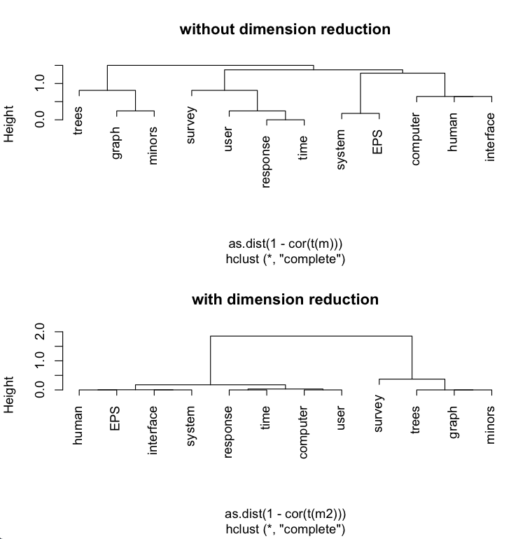
plot(hclust(as.dist(1-cor(t(m))))
 | c1 | c2 | c3 | c4 | c5 | m1 | m2 | m3 | m4
human | 1 | 0 | 0 | 1 | 0 | 0 | 0 | 0 | 0
interface | 1 | 0 | 1 | 0 | 0 | 0 | 0 | 0 | 0
computer | 1 | 1 | 0 | 0 | 0 | 0 | 0 | 0 | 0
user | 0 | 1 | 1 | 0 | 1 | 0 | 0 | 0 | 0
system | 0 | 1 | 1 | 2 | 0 | 0 | 0 | 0 | 0
response | 0 | 1 | 0 | 0 | 1 | 0 | 0 | 0 | 0
time | 0 | 1 | 0 | 0 | 1 | 0 | 0 | 0 | 0
EPS | 0 | 0 | 1 | 1 | 0 | 0 | 0 | 0 | 0
survey | 0 | 1 | 0 | 0 | 0 | 0 | 0 | 0 | 1
trees | 0 | 0 | 0 | 0 | 0 | 1 | 1 | 1 | 0
graph | 0 | 0 | 0 | 0 | 0 | 0 | 1 | 1 | 1
minors | 0 | 0 | 0 | 0 | 0 | 0 | 0 | 1 | 1

Slide 19
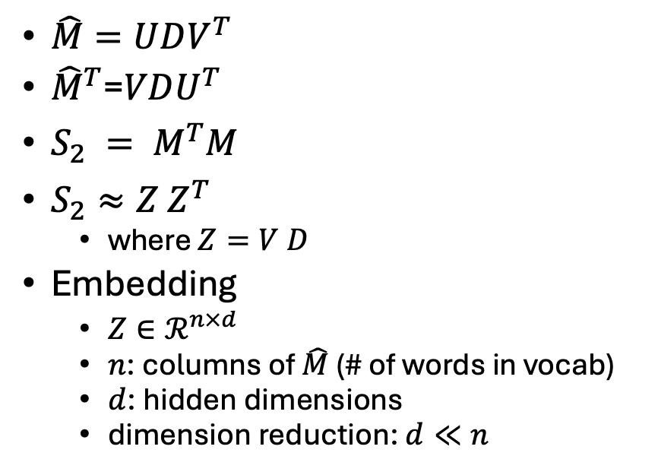
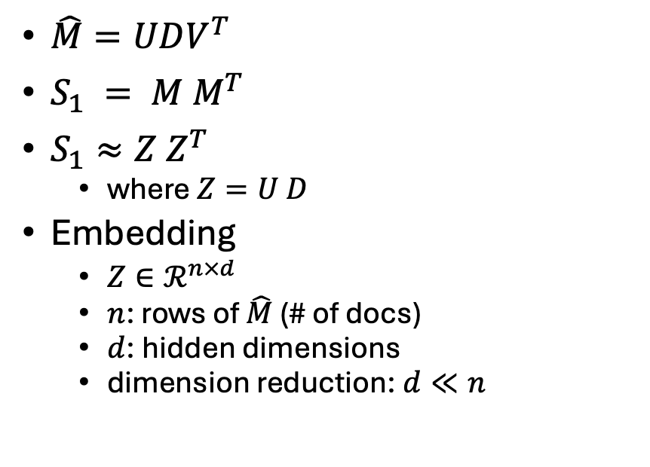
Similarity Matrix (S) → Embedding (Z)
Similarity of columns
Similarity of rows
$\hat{M}=UDV^{T}$
$S_{1} = M M^{T}$
$S_{1}≈Z Z^{T}$
where $Z=U D$
Embedding
$Z∈ℛ^{n×d}$
$n$: rows of $\hat{M}$ (# of docs)
$d$: hidden dimensions
dimension reduction: $d≪n$
$\hat{M}=UDV^{T}$
${\hat{M}}^{T}$=$VDU^{T}$
$S_{2} = M^{T}M$
$S_{2}≈Z Z^{T}$
where $Z=V D$
Embedding
$Z∈ℛ^{n×d}$
$n$: columns of $\hat{M}$ (# of words in vocab)
$d$: hidden dimensions
dimension reduction: $d≪n$

Slide 20
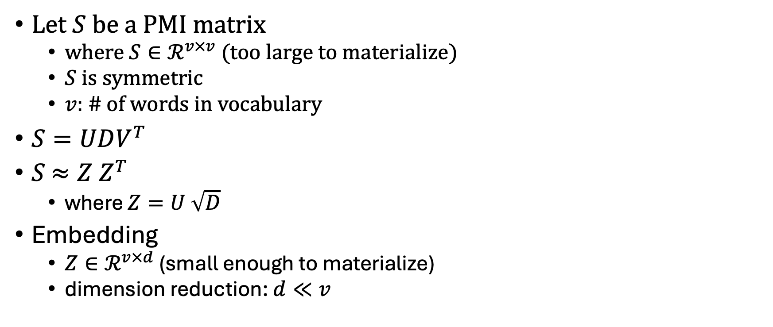
PMI Matrix (S) → Embedding (Z)
Let $S$ be a PMI matrix
where $S∈ℛ^{v×v}$ (too large to materialize)
$S$ is symmetric
$v$: # of words in vocabulary
$S=UDV^{T}$
$S$ $≈Z Z^{T}$
where $Z=U \sqrt{D}$
Embedding
$Z∈ℛ^{v×d}$ (small enough to materialize)
dimension reduction: $d≪v$

Slide 21
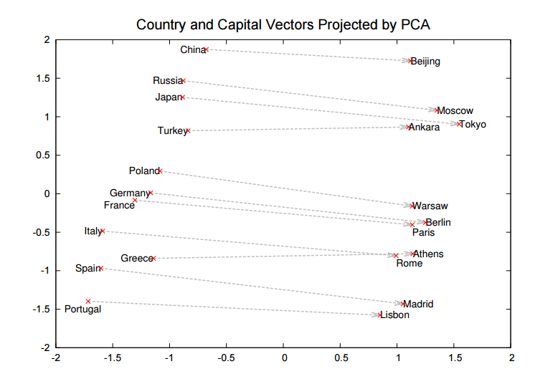

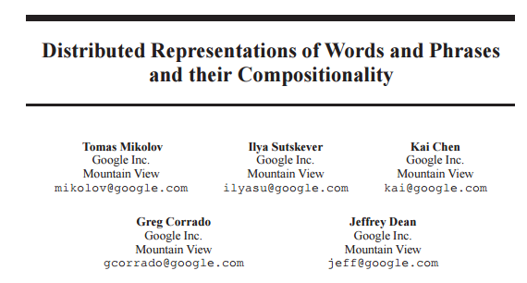
Word2Vec: $sim\left(x,y\right)=\cos\left(vec\left(x\right), vec\left(y\right)\right)≈PMI(x,y)$ https://code.google.com/archive/p/word2vec/
Linguistic generalizations
Word associations (dist in plot)
Features (red line)
Countries & Capitals
Analogies:
Man : Woman :: King : x
x → queen
Athens : Greece :: Bangkok: x
x → Thailand

Slide 22
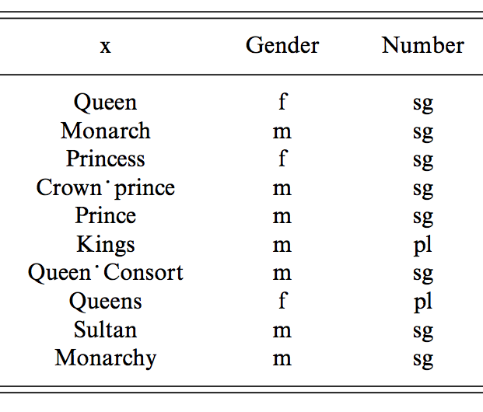
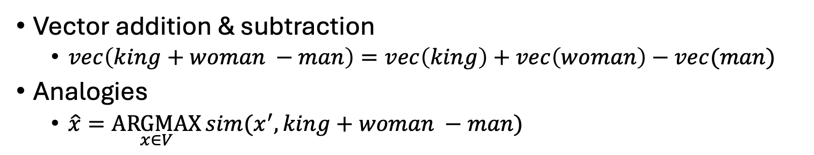
man : woman :: king : x
Vector addition & subtraction
$vec\left(king+woman −man\right)=vec\left(king\right)+vec\left(woman\right)−vec(man)$
Analogies
$\hat{x}=\underset{x∈V}{ARGMAX}{sim(x^{′}, king+woman −man)}$
Near misses

Slide 23
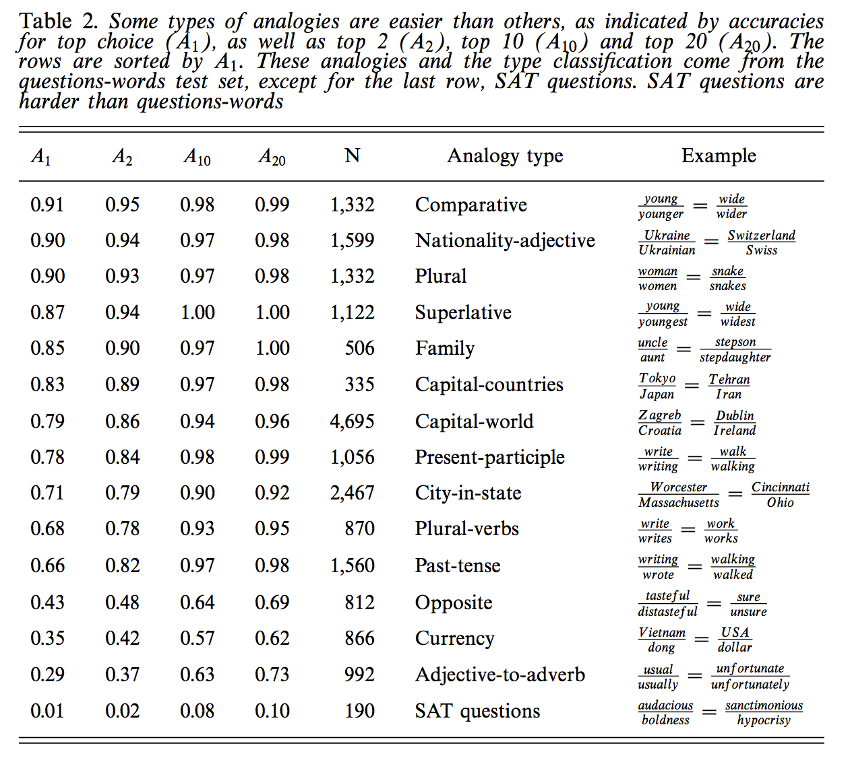
Some analogies are easier than others
Tweets
RT @tallinzen: sure, king:queen etc, but did you know word2vec gets real SAT analogies right just 1% of the time?
15 copies of this tweet
Some by NLP experts
Resources Debate
WordNet &
British National Corpora

Slide 24
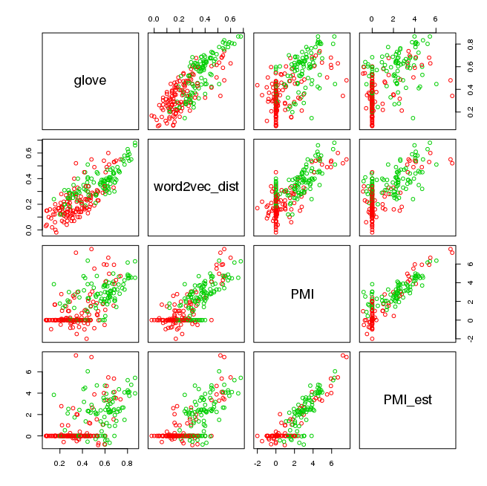
Levy & Goldberg (NIPS-2014) Word2Vec ≈ PMI (Pointwise Mutual Info)
Levy & Goldberg (NIPS-2014) is a theoretical arg
Plots → correlations are large, but far from perfect
Materials:
N = 22 words (11 cities + 11 countries)
N (N-1)/2 = 231 pairs of words (points)
type in {city, country}
Color:
Green → type match
Red → type mismatch

Slide 25

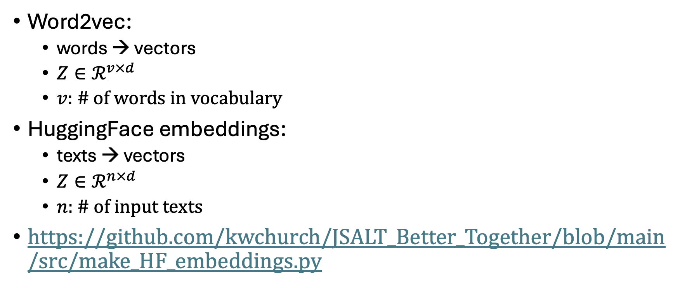
PMI → Word2Vec → HuggingFace embeddings
Word2vec:
words → vectors
$Z∈ℛ^{v×d}$
$v$: # of words in vocabulary
HuggingFace embeddings:
texts → vectors
$Z∈ℛ^{n×d}$
$n$: # of input texts
https://github.com/kwchurch/JSALT_Better_Together/blob/main/src/make_HF_embeddings.py

Slide 26
Conclusions
Bigger Picture: A personal perspective not found in textbooks
Corpora
Lexical Semantics
Word Associations
Information Theory
PMI → Word2Vec → Bots

